Slide 1

CND
VLSI Project
Transistor Sizing
Submitted by: Nada, Fagr and Mohamed

Slide 2

Intro
Fagr Ahmed
Nada Waleed
Mohamed Yasser

Slide 3

Automatic Transistor Sizing
Optimal gate sizing of transistors is amongst the fundamental problems in VLSI circuit designing. Size of transistors in any CMOS logic circuit directly affects its performance in terms of speed, power dissipation etc.

Slide 4
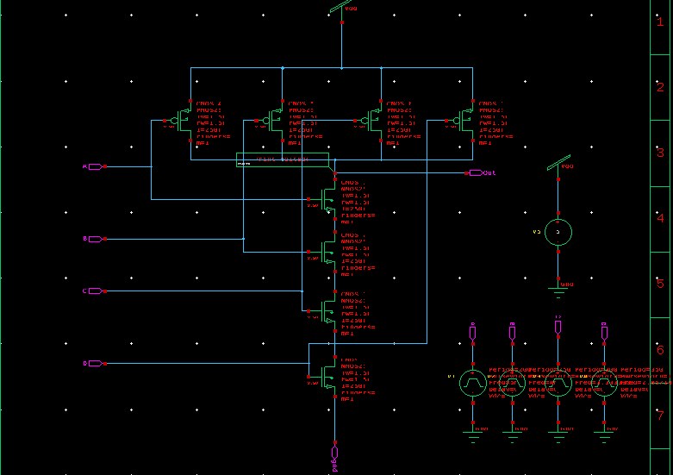
NAND Circuit

Slide 5
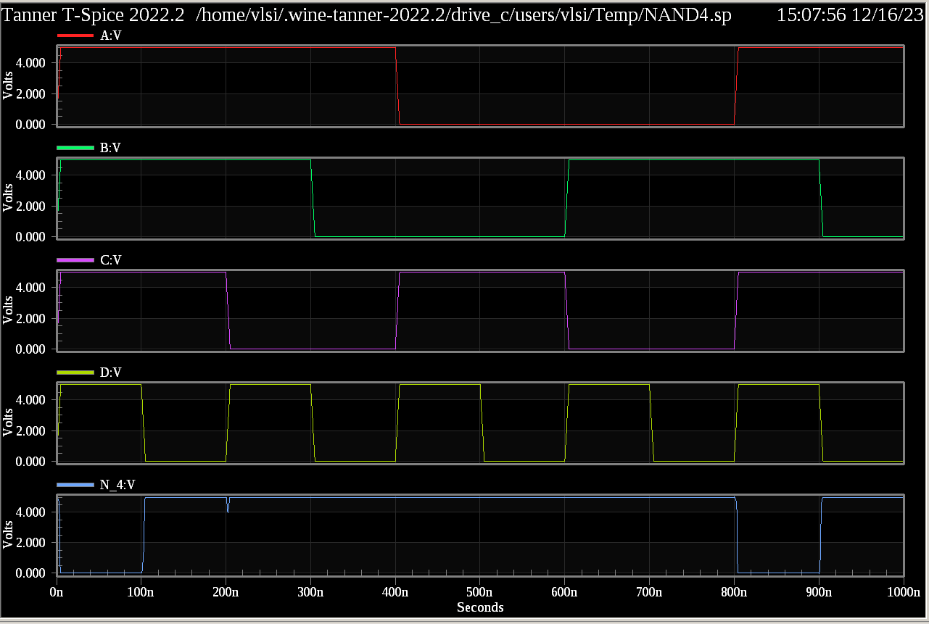
NAND Output-Wave

Slide 6
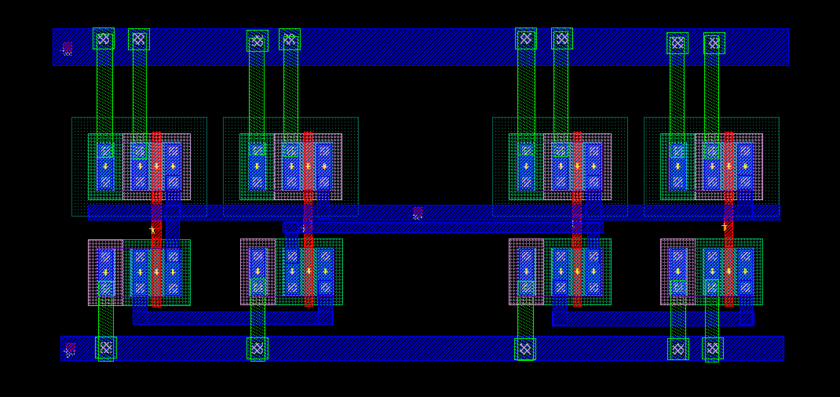
NAND Layout

Slide 7
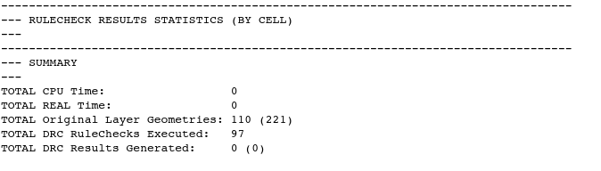
NAND DRC

Slide 8
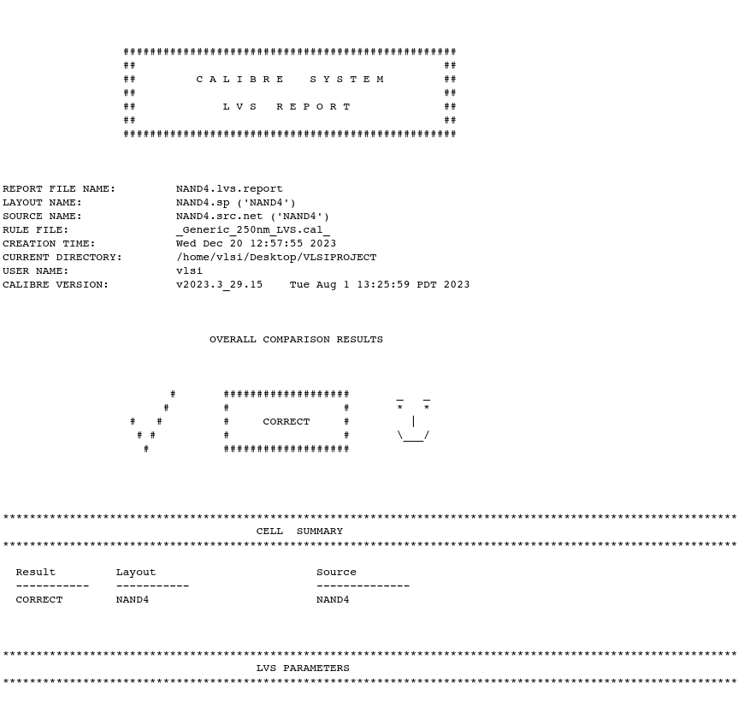
NAND LVS

Slide 9
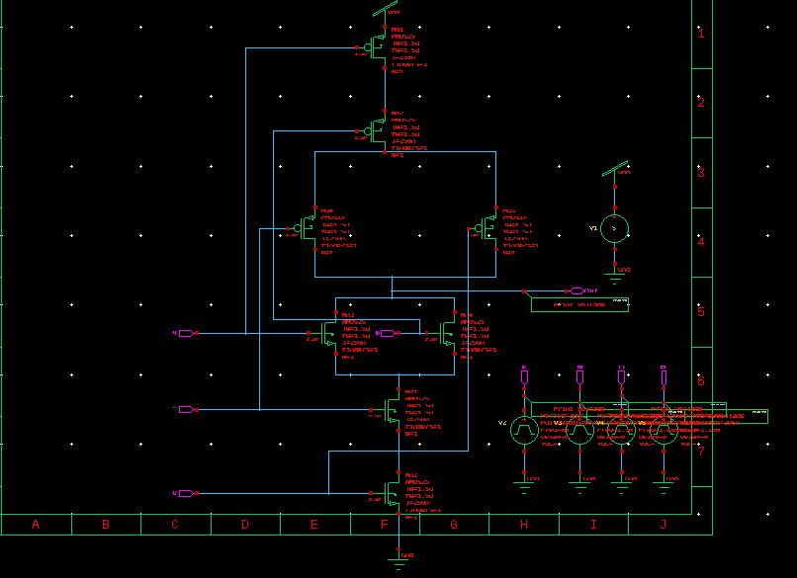
AND-OR Circuit

Slide 10
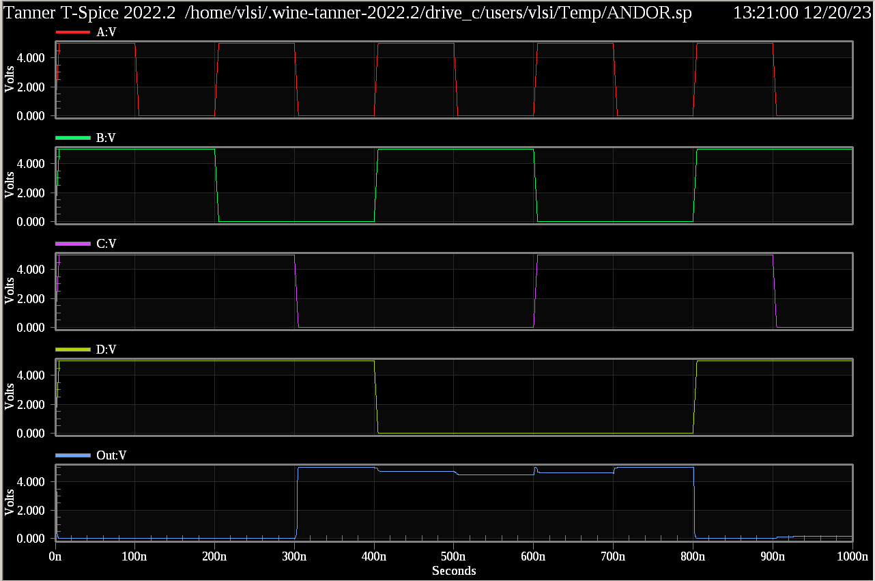
AND-OR Output Wave

Slide 11
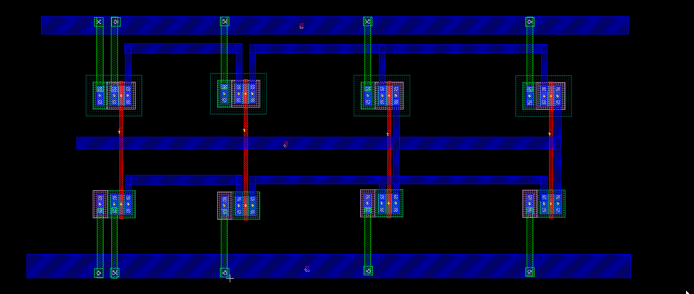
AND-OR Layout

Slide 12
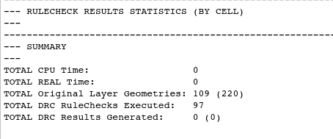
AND-OR DRC

Slide 13
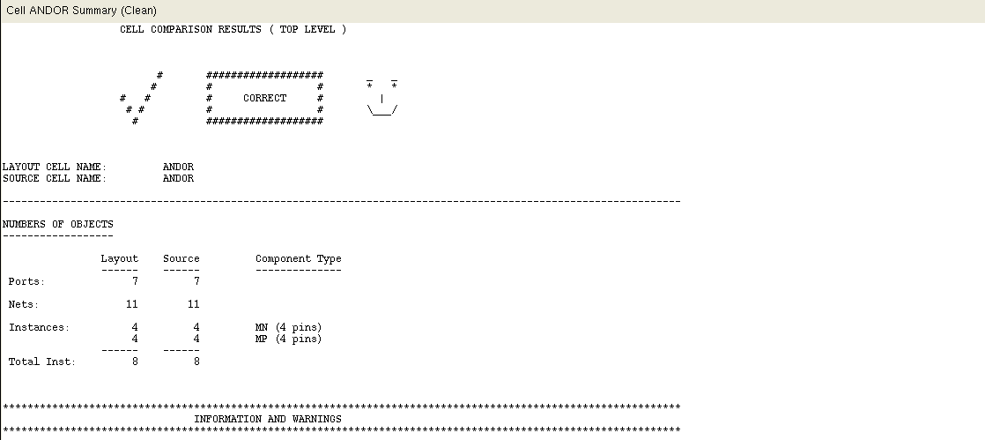
AND-OR LVS

Slide 14
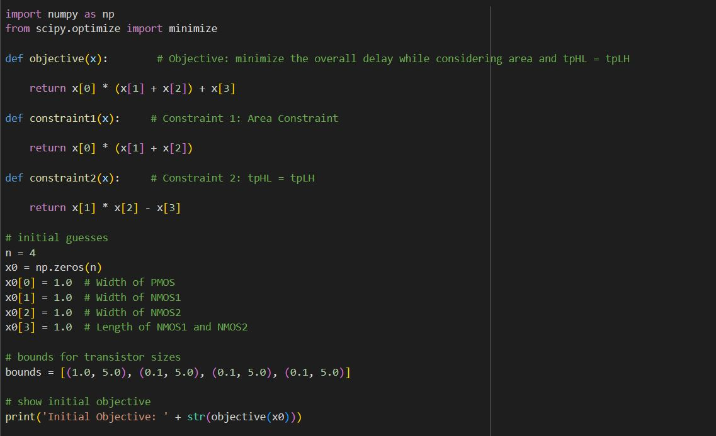
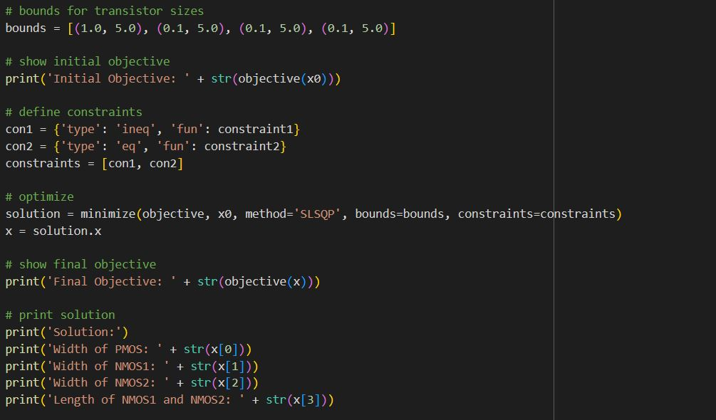
Code Snippets

Slide 15

Thanks!

